Slide 1


GreenABR: Energy-Aware Adaptive Bitrate Streaming with Deep Reinforcement Learning
Bekir Oguzhan Turkkan*, Ting Dai⁺, Adithya Raman*, Tevfik Kosar*, Changyou Chen*, Muhammed Fatih Bulut⁺, Jaroslaw Zola*, Daby Sow⁺
*University at Buffalo , ⁺IBM Research

Slide 2

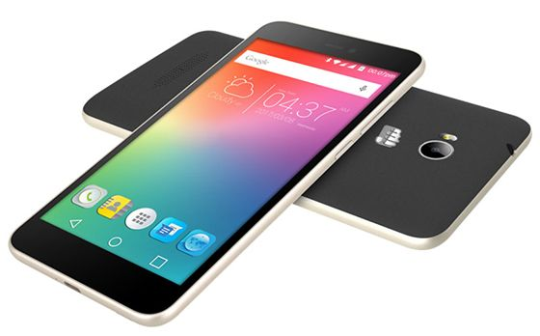
Introduction
Global Traffic
Mobile Traffic
60%
79%
Diverse clients and streaming conditions
HTTP Streaming – Standardized as DASH streaming
Adaptive Bitrate Algorithms (ABR)
Energy consumption is an important constraint for mobile users
Quality
Stalling
Oscillations
QoE

Slide 3
State of the Art
QoE Targeted
Rule-based Models
Learning-based Models
Energy Aware
Context aware
Additional layer
BOLA [INFOCOM ’16][1]
Pensieve [SIGCOMM ’17][5]
Fugu [NSDI ’20][7]
Using other codecs
Progressive download
Data/quality budget
QUAD [MMSys ’19][16], DataPlanner [MMSys ’21][17]
EnDASH [IFIP ’20][13], Breitbach et al. [CCNC ’18][14], Meng et al. [ATC ’21][15]
Vitto et al. [ICMEW ’18][12]
ef-HAS [IEEE ’18][10], e-DASH [WoWMoM ’17][11]
Chen et al. [ICDCS ’19][9]
Festive [CoNEXT ’12][2]
MPC [SIGCOMM ’15][3]
BOLAE, Dynamic ABR [MMSys ’18][4]
Oboe [SIGCOMM ’18][6]
Comyco [MM ’19][8]

Slide 4
Limitations of Existing Studies
Training stability and efficiency
Pensieve, Comyco, Oboe
Do not consider the perceptual quality
Bola, Festive, MPC, BolaE, DynamicABR, Pensieve, Oboe, ef-HAS, e-DASH, EnDASH
Either do not consider energy consumption
Bola, Festive, MPC, BolaE, DynamicABR, Pensieve, Oboe, Fugu, Comyco
Or sacrifice QoE to save power consumption
ef-HAS, e-DASH, EnDASH

Slide 5
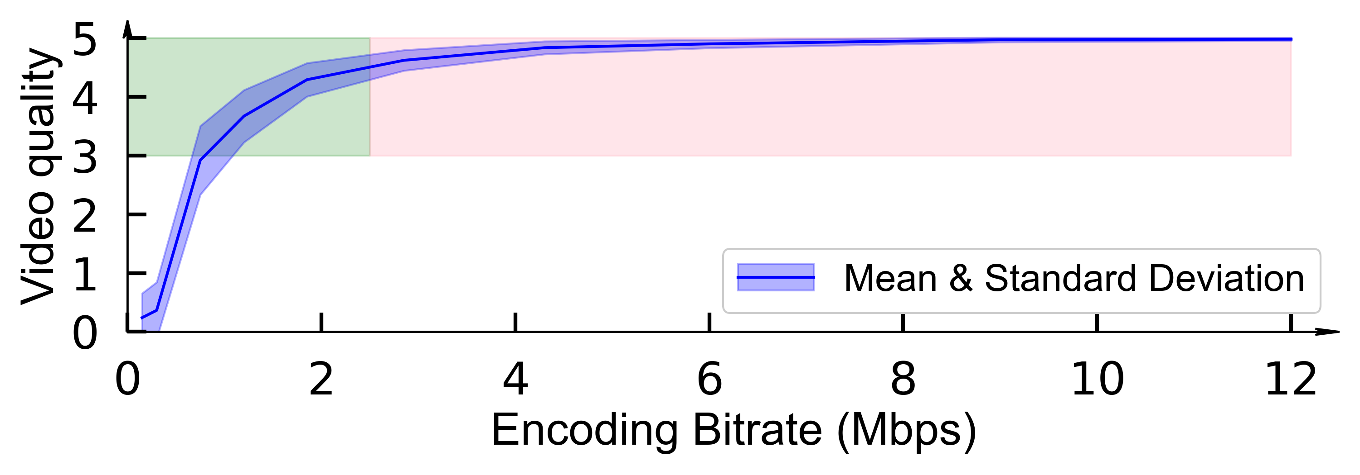
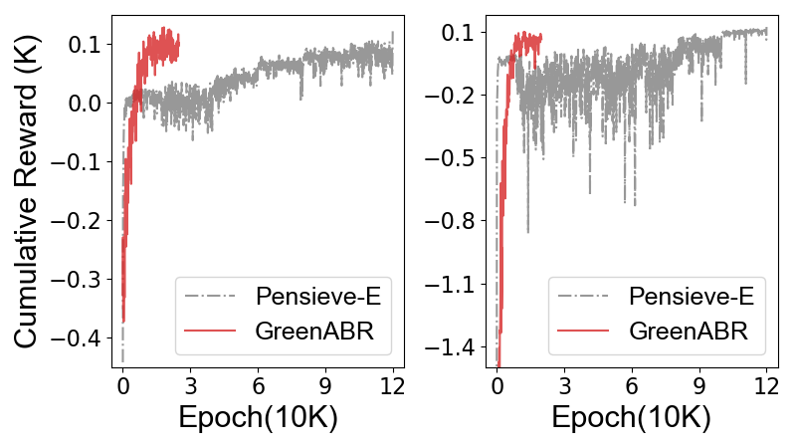
To Address Limitations
stability&efficiency
perceptual quality
DQN
VMAF
energy consumption
sacrifice QoE
Optimize for both

Slide 6
GreenABR: Energy-Aware Adaptive Bitrate Streaming with Deep Reinforcement Learning
Optimizes QoE and energy together
Targets high perceptual quality
Minimizes rebuffering events and quality oscillations
Minimizes capacity violations
Reduces the energy and data consumption
Designed for general video streaming scenarios
Does not require additional hardware support (e.g., HEVC support )

Slide 7
GreenABR Design

Slide 8





Modelling Power Consumption
Limitations of existing models
Designed based on encoding bitrate
Device heterogeneity
Our approach
Considers ABR-related components
Targets to capture pattern
Minimizes device specific impacts
Excludes base power consumption
Video Processing
Display
Data Acquisition
Local Playback
Audio Processing
Speaker

Slide 9
Power Model
Local Play Energy
Video processing + Display
Parameters affect non-linearly
Regression model
RMSE < 0.01 <7% estimation error
Evaluations on unseen device
RMSE < 0.036 <12% estimation error
Data Acquisition Energy
Adopt an existing model [18]
Compatible throughput range
Accurate with > 90%

Slide 10
DQN architecture in GreenABR
Reward Model
+ quality(VMAF)
- rebuffering(time)
- oscillations(VMAF)
- energy usage
Estimated by Power Model

Slide 11
Evaluation Setup
Videos
Tears of steel (sci-fi), Nature(documentary), BBB(cartoon)
6-reps (0.3-4.3 Mbps), 10-reps (0.1-12Mbps), 10-HD-reps (2K&4K)
Energy Data Collection
Monsoon Power meter collects at each 200 microseconds
Results are aggregated for each chunk
Traces
3G, 4G-LTE, Broadband, Synthetic
Perceptual Quality Calculation
QoE of the streaming session
video quality, rebuffering time and frequency, oscillations, quality switches
Linear regression model on SQoE-III[19] dataset

Slide 12



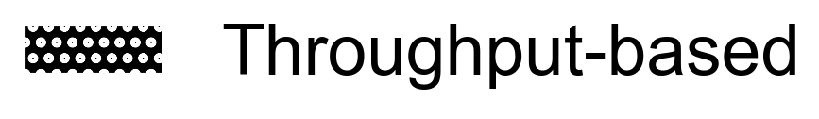
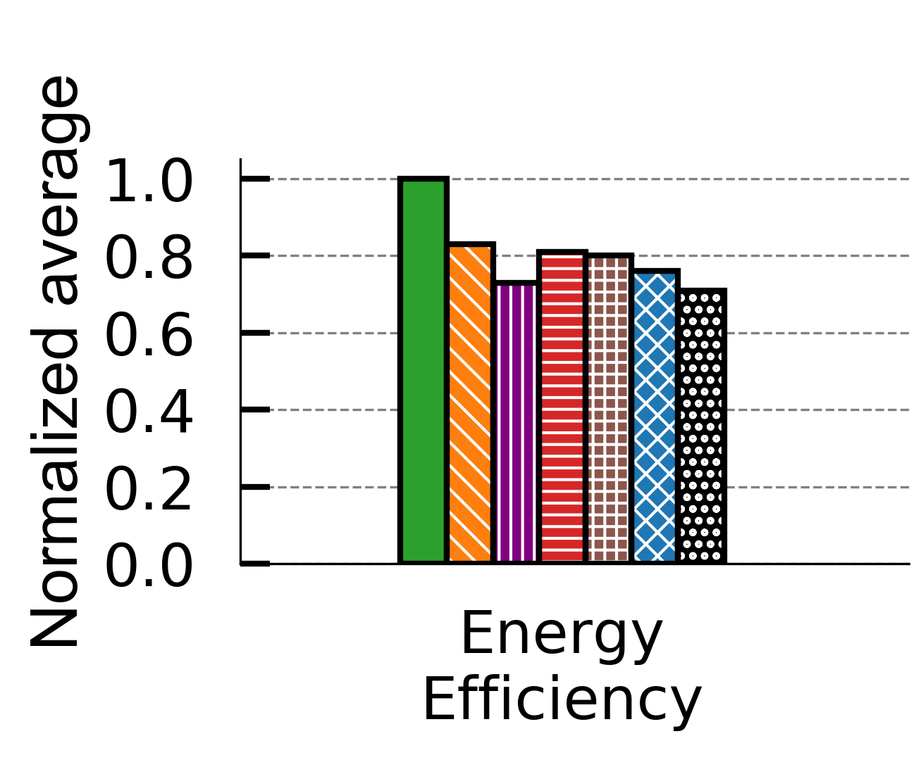



Results - 6 representations
17-29% better
(QoE/Energy)

Slide 13
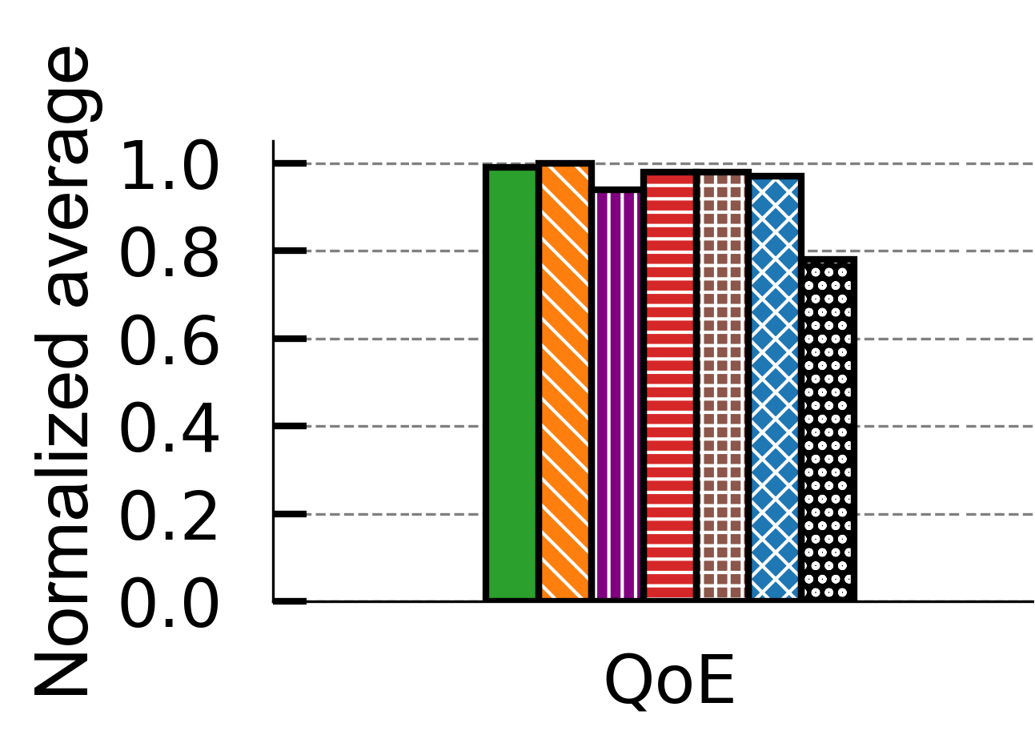
Results - 6 representations
1% degradation

Slide 14
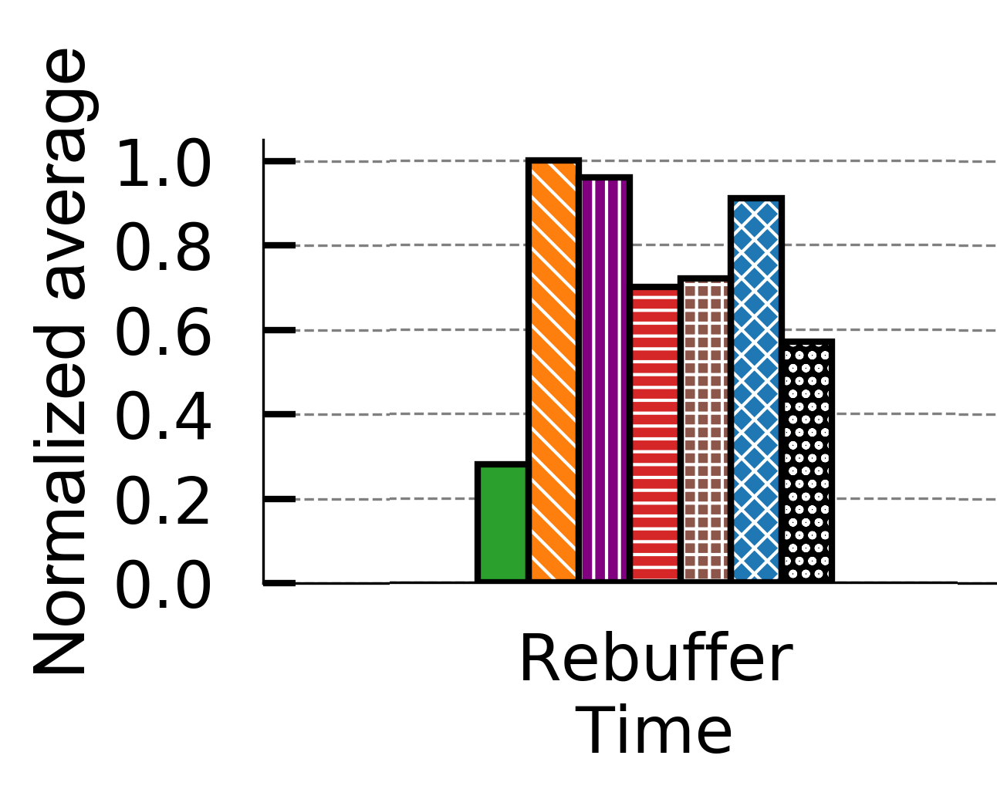
Results - 6 representations
49-72% lower

Slide 15
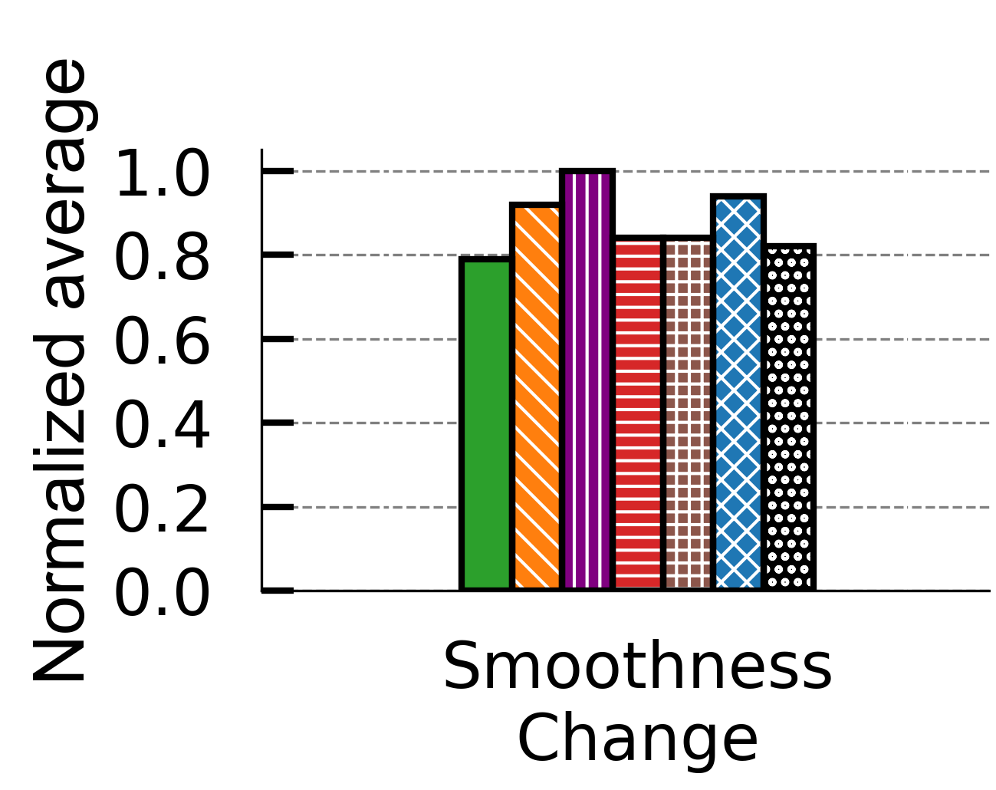
Results - 6 representations
2-21% lower

Slide 16
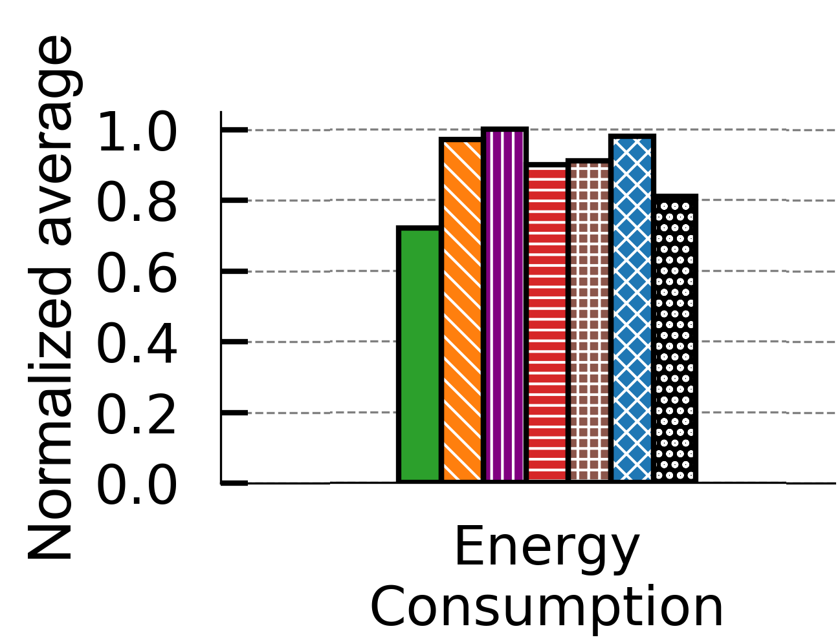
Results - 6 representations
11-28% savings

Slide 17
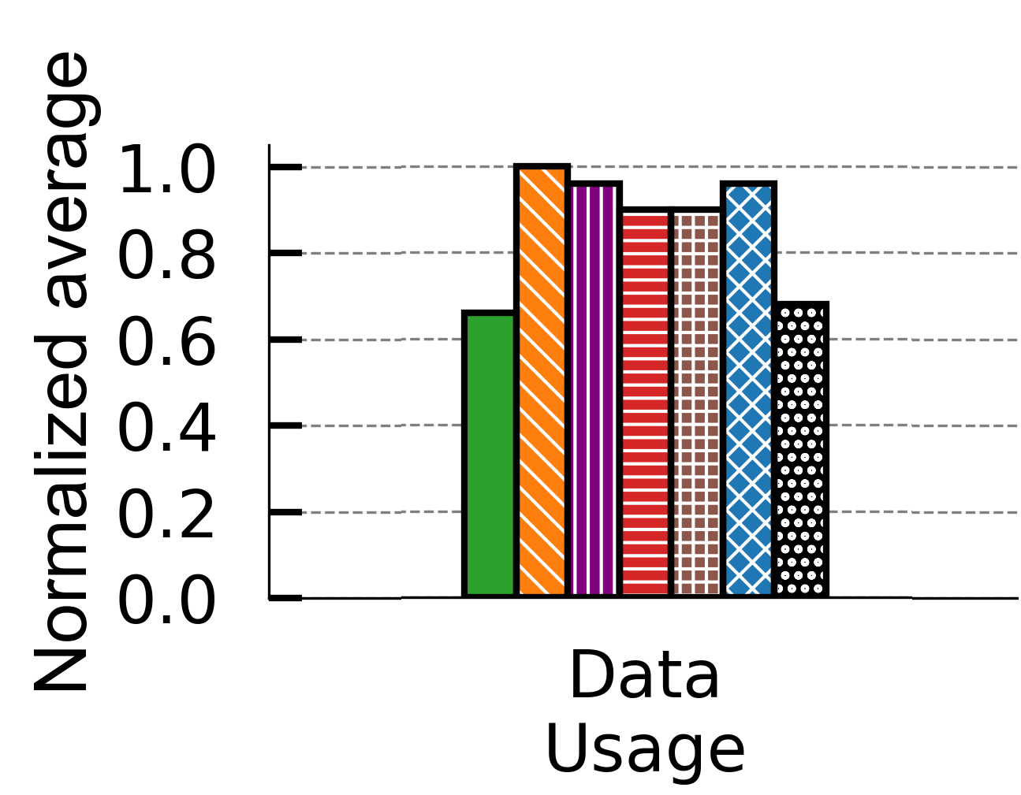
Results - 6 representations
3-44% savings

Slide 18
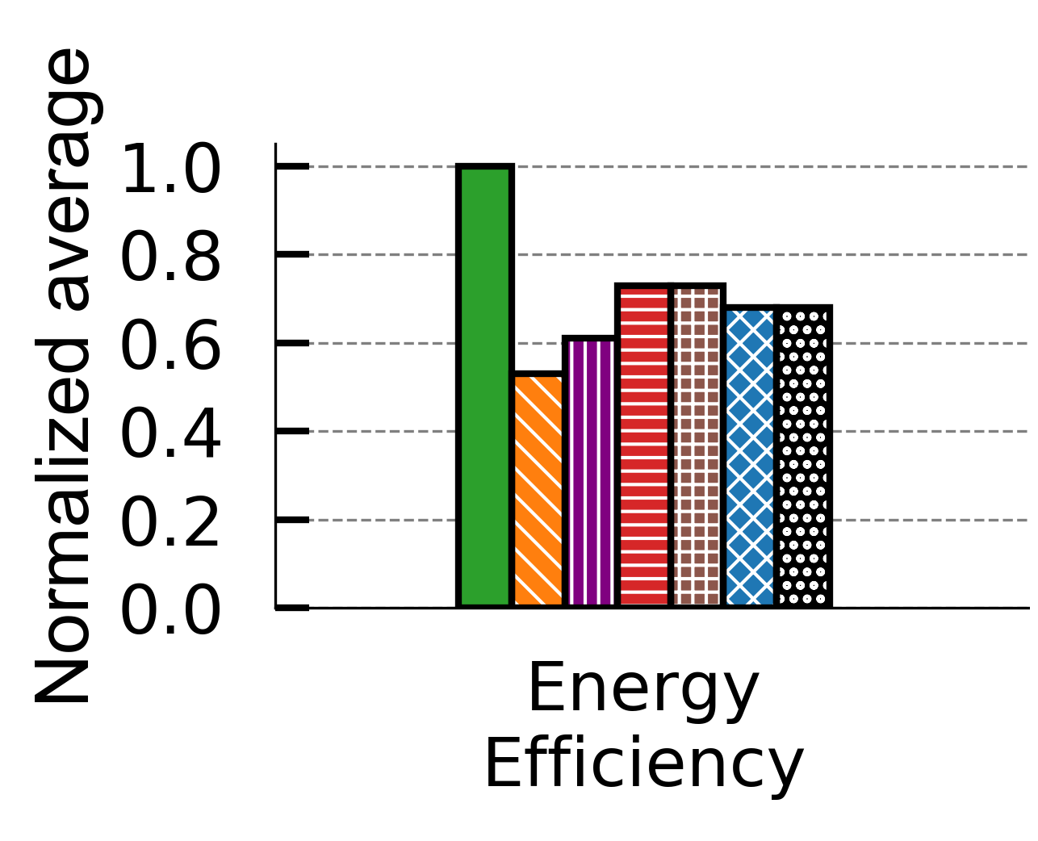
Results - 10 representations
27-47% better

Slide 19
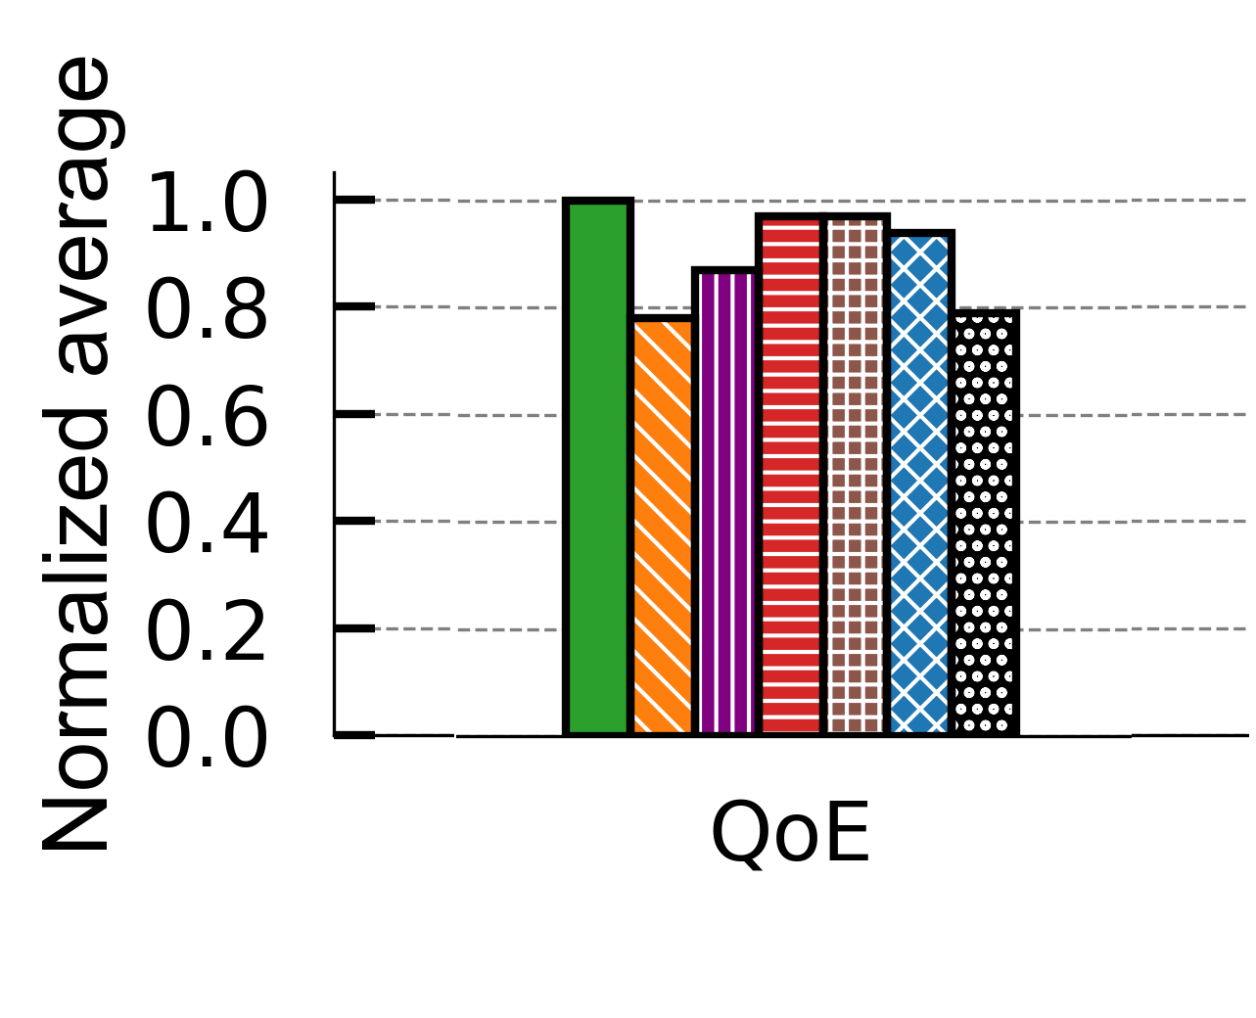
Results - 10 representations
3-22% better

Slide 20
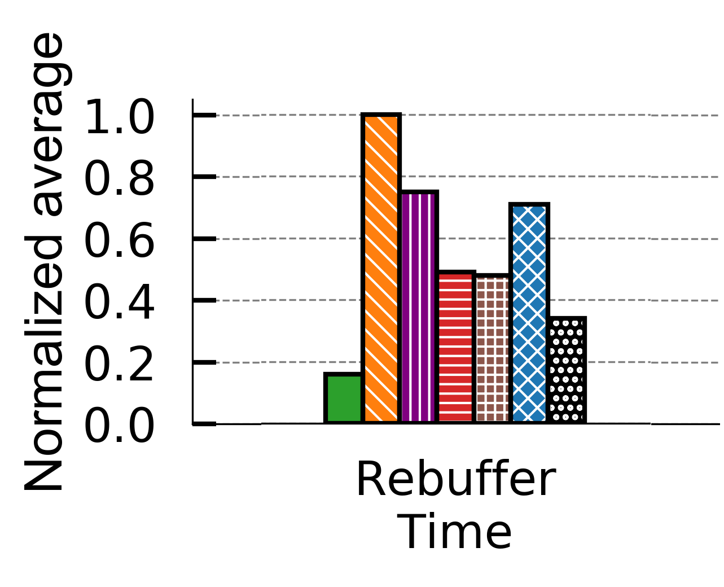
Results - 10 representations
53-84% lower

Slide 21
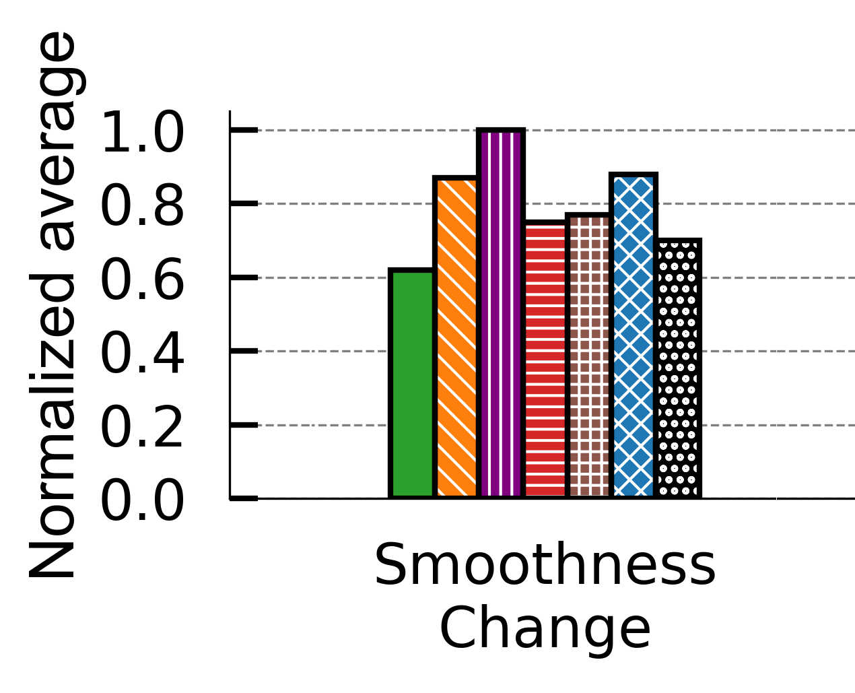
Results - 10 representations
16-31% lower

Slide 22
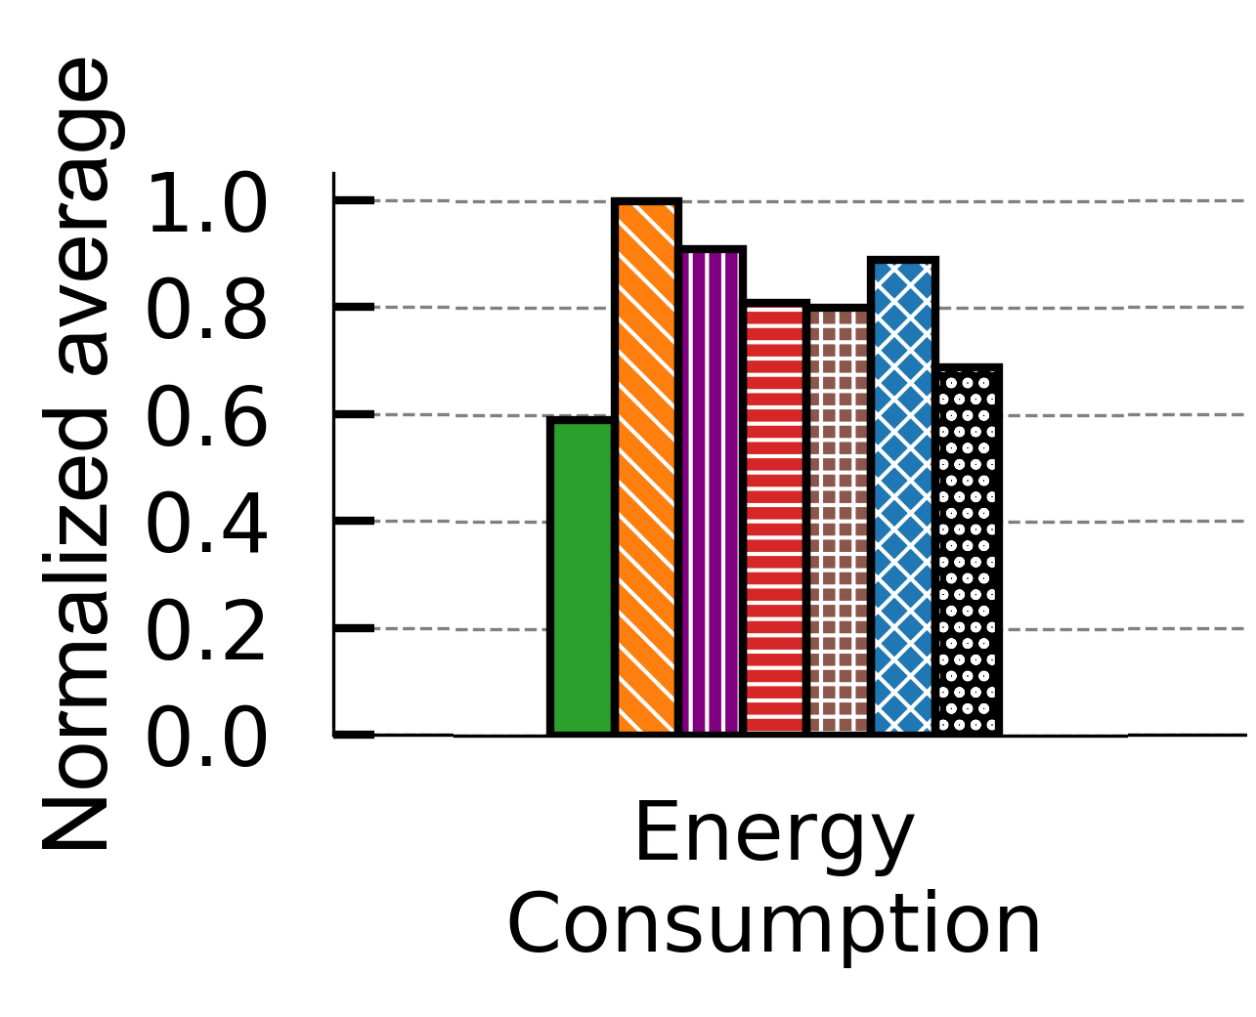
Results - 10 representations
15-41% savings

Slide 23
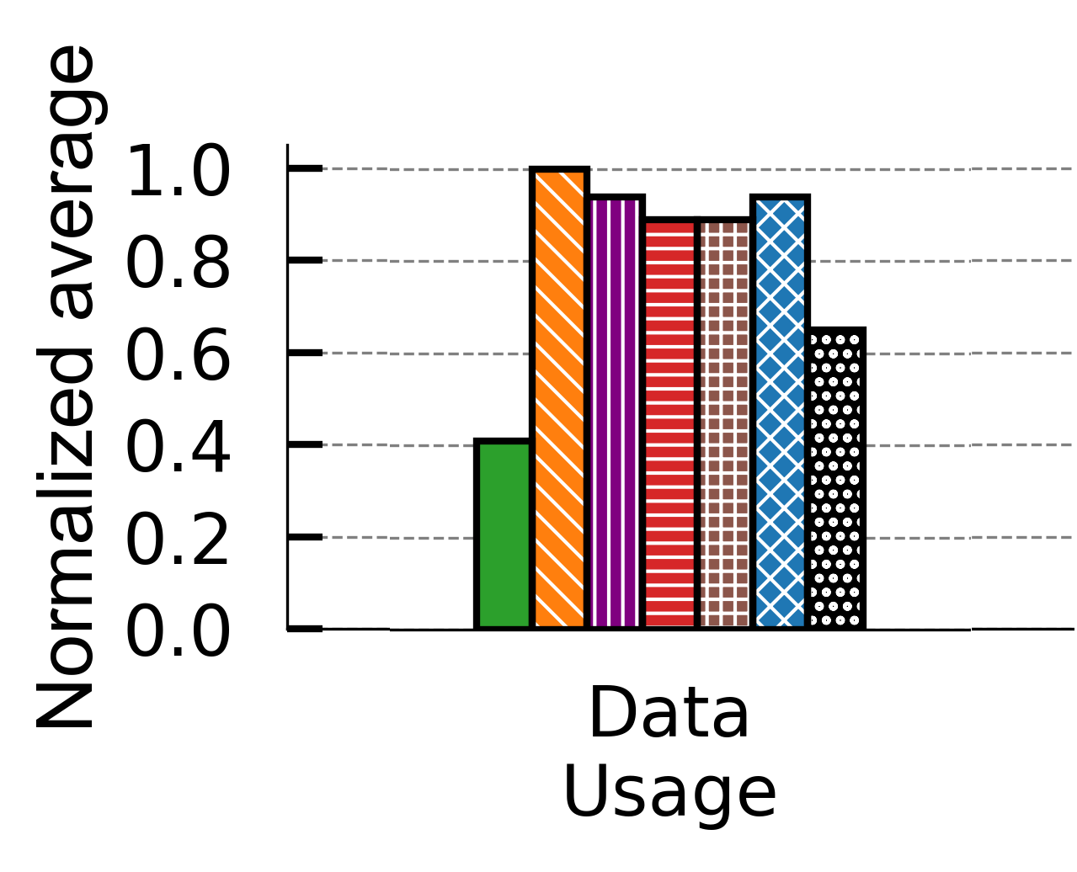
Results - 10 representations
36-59% savings

Slide 24
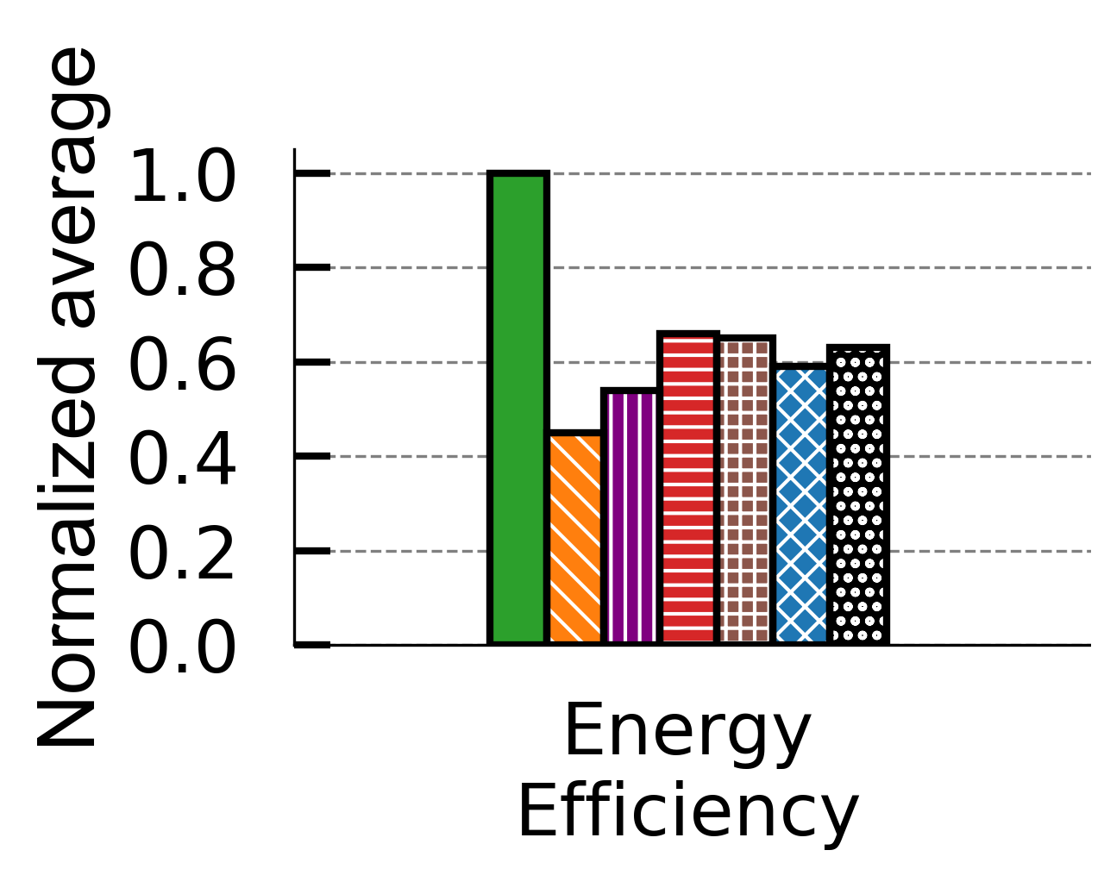
Results – 10 representations (2K-4K)
34-55% better

Slide 25
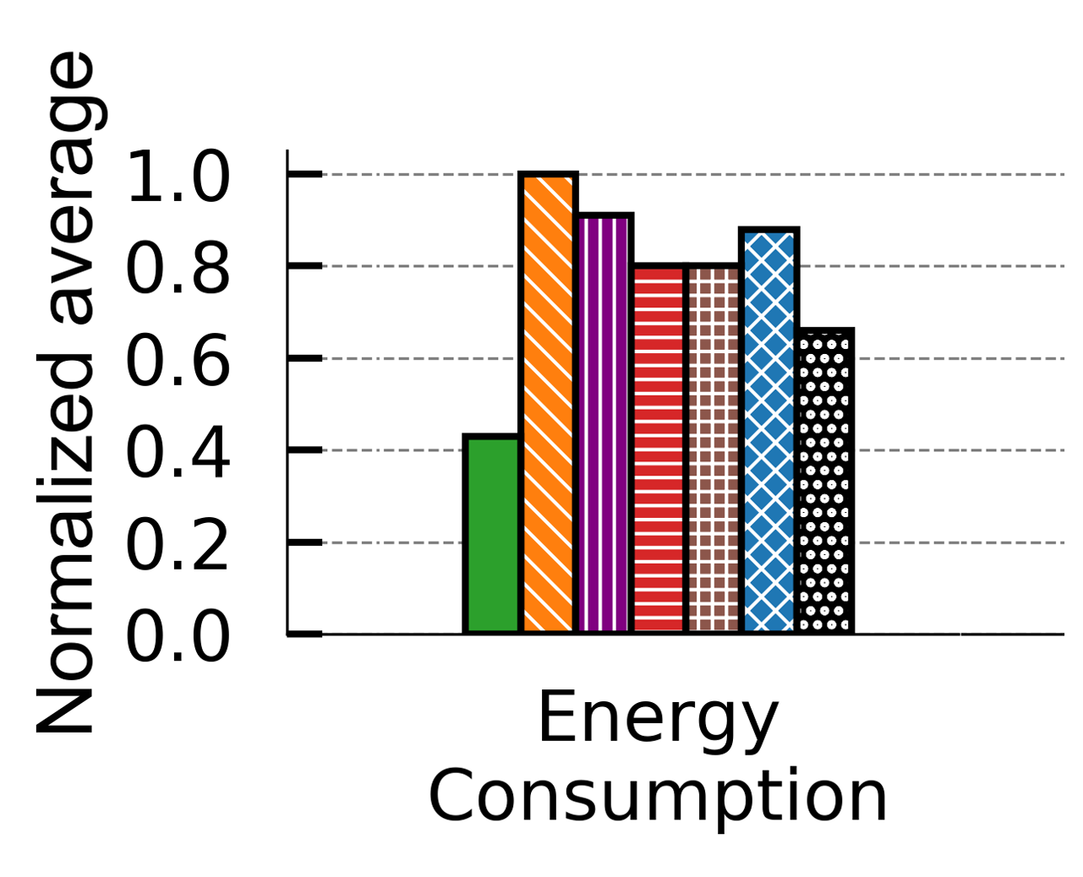
Results - 10 representations (2K-4K)
35-57% savings

Slide 26
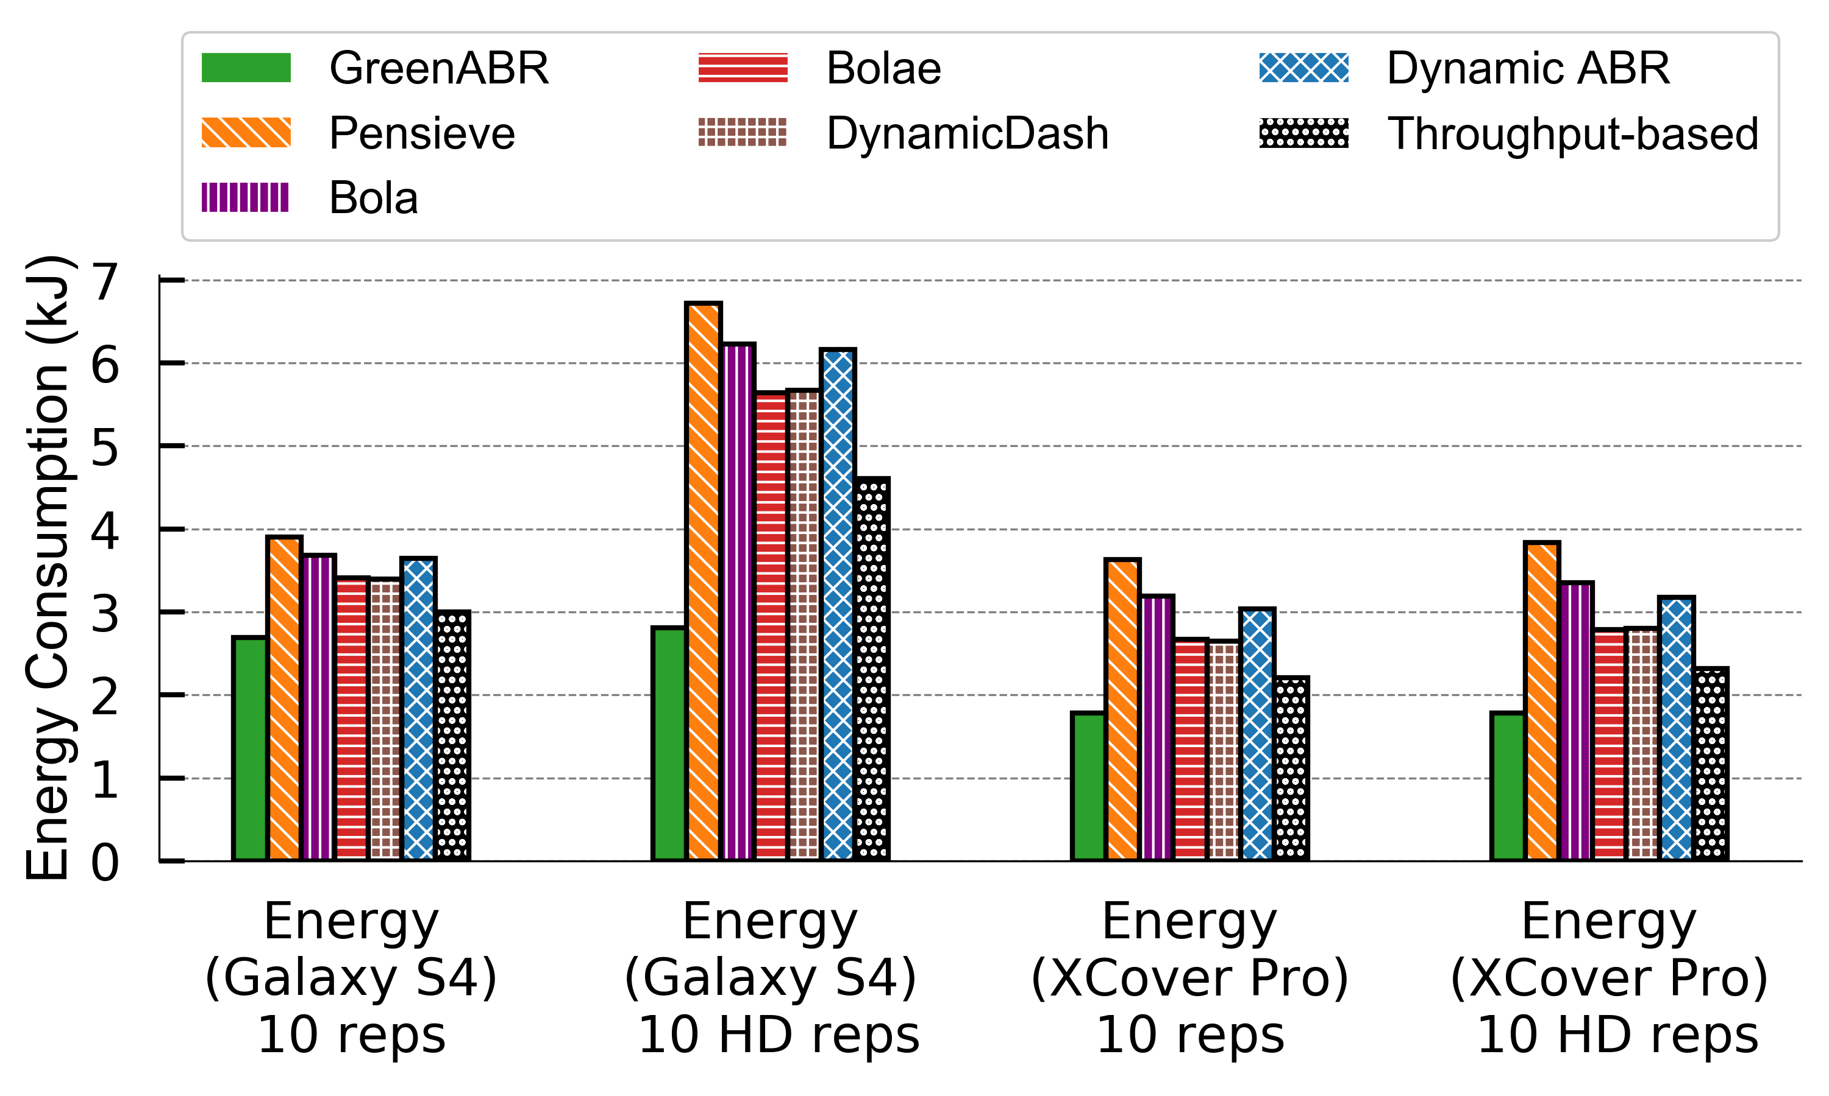
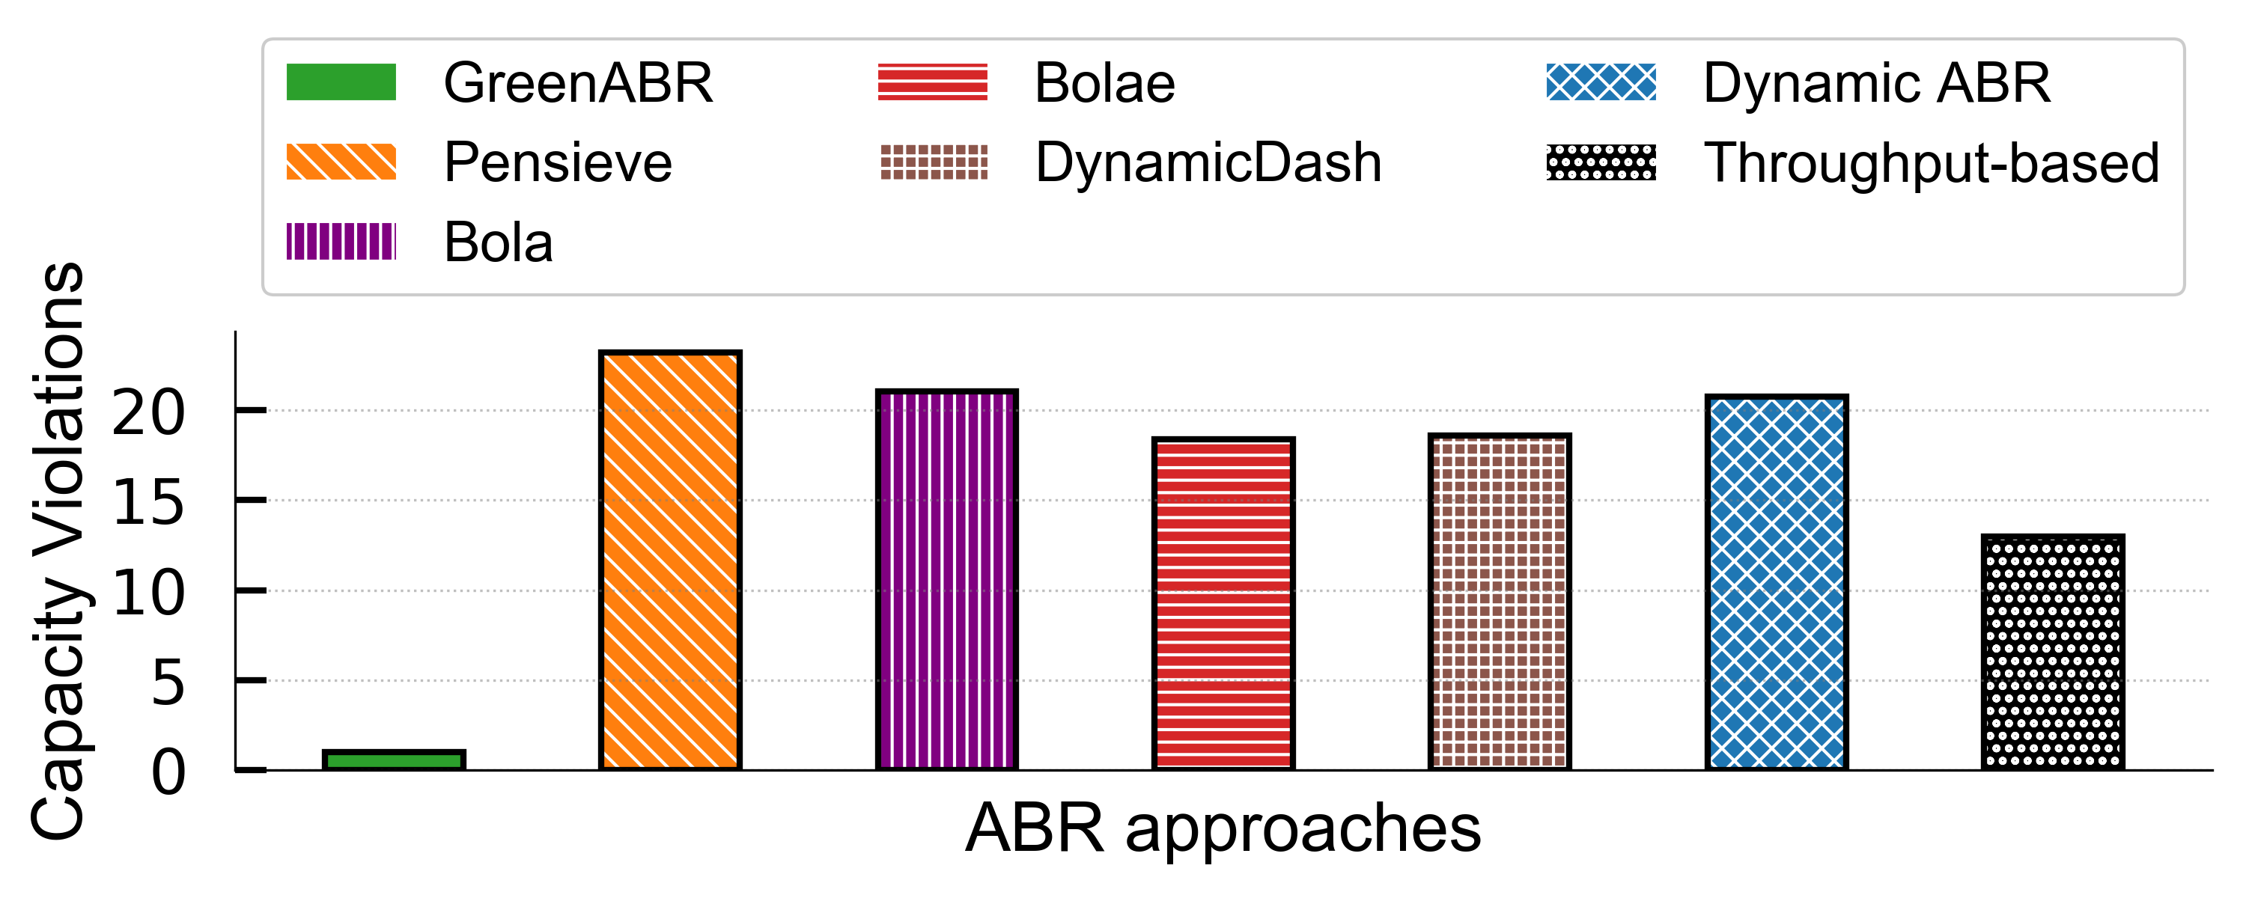
Energy Consumption & Capacity Violations
Energy Consumption Analysis
Slight increase for Xcover Pro
GreenABR preserves its efficiency
Other ABRs doubles their energy consumption
Pixel Rate > Decoder Capacity
Software decoder takes over
Drops frames
Boosts Energy Consumption

Slide 27
Summary
RL models improve ABRs
Requires training efficiency and stability
Perceptual quality metrics (e.g.,VMAF) improve ABRs
Bitrate greedy approaches
Fail for unstable network conditions
Incur additional power and data usage
Sustainable solutions needed for mobile users
Standardized evaluations needed to avoid unfair comparisons
GreenABR outperforms SOTA up to
57% energy savings
22% QoE
60% data savings
84% less rebuffering

Slide 28
Future Work
Generalized GreenABR for different encoding ladders
GreenABR for live streaming scenarios
GreenABR on server side

Slide 29

Questions

Slide 30
References
K. Spiteri, R. Urgaonkar, and R. K. Sitaraman. 2016. BOLA: Near-optimal bitrate adaptation for online videos. In IEEE INFOCOM 2016 - The 35th Annual IEEE International Conference on Computer Communications. 1–9
Junchen Jiang, Vyas Sekar, and Hui Zhang. 2012. Improving Fairness, Efficiency, and Stability in HTTP-Based Adaptive Video Streaming with FESTIVE (CoNEXT ’12). New York, NY, USA, 97–108.
Yasir Zaki, Thomas Pötsch, Jay Chen, Lakshminarayanan Subramanian, and Carmelita Görg. 2015. Adaptive Congestion Control for Unpredictable Cellular Networks. In Proceedings of the 2015 ACM Conference on Special Interest Group on Data Communication (London, United Kingdom) (SIGCOMM ’15).
Kevin Spiteri, Ramesh Sitaraman, and Daniel Sparacio. 2018. From Theory to Prac- tice: Improving Bitrate Adaptation in the DASH Reference Player. In Proceedings of the 9th ACM Multimedia Systems Conference (Amsterdam, Netherlands) (MMSys ’18).
Hongzi Mao, Ravi Netravali, and Mohammad Alizadeh. 2017. Neural Adaptive Video Streaming with Pensieve. In Proceedings of the Conference of the ACM Special Interest Group on Data Communication (Los Angeles, CA, USA) (SIGCOMM ’17).
Zahaib Akhtar, Yun Seong Nam, Ramesh Govindan, Sanjay Rao, Jessica Chen, Ethan Katz-Bassett, Bruno Ribeiro, Jibin Zhan, and Hui Zhang. 2018. Oboe: Auto- Tuning Video ABR Algorithms to Network Conditions. In Proceedings of the 2018 Conference of the ACM Special Interest Group on Data Communication (Budapest, Hungary) (SIGCOMM ’18).
FrancisY.Yan,HudsonAyers,ChenzhiZhu,SadjadFouladi,JamesHong,Keyi Zhang, Philip Levis, and Keith Winstein. 2020. Learning in situ: a randomized experiment in video streaming. In 17th USENIX Symposium on Networked Systems Design and Implementation (NSDI 20).
Tianchi Huang, Chao Zhou, Rui-Xiao Zhang, Chenglei Wu, Xin Yao, and Lifeng Sun. 2019. Comyco: Quality-Aware Adaptive Video Streaming via Imitation Learning. CoRR abs/1908.02270 (2019).
B. Varghese, G. Jourjon, K. Thilakarathne, and A. Seneviratne. 2017. e-DASH: Modelling an energy-aware DASH player. In 2017 IEEE 18th International Sym- posium on A World of Wireless, Mobile and Multimedia Networks (WoWMoM).

Slide 31
References
S. Kim, H. Oh, and C. Kim. 2018. eff-HAS: Achieve higher efficiency in data and energy usage on dynamic adaptive streaming. Journal of Communications and Networks 20, 3 (2018), 325–342.
M. Uitto and M. Forsell. 2018. Towards Energy-Efficient Adaptive Mpeg-Dash Streaming Using Hevc. In 2018 IEEE International Conference on Multimedia Expo Workshops (ICMEW). 1–6.
X. Chen, T. Tan, and G. Cao. 2019. Energy-Aware and Context-Aware Video Streaming on Smartphones. In 2019 IEEE 39th International Conference on Dis- tributed Computing Systems (ICDCS). 861–870.
A. Mondal, B. Palit, S. Khandelia, N. Pal, J. Jayatheerthan, K. Paul, N. Ganguly, and S. Chakraborty. 2020. EnDASH - A Mobility Adapted Energy Efficient ABR Video Streaming for Cellular Networks. In 2020 IFIP Networking Conference (Networking). 127–135.
T. Breitbach, P. Sanders, and D. Schultes. 2018. Optimizing energy consumption and user experience in a mobile video streaming scenario. In 2018 15th IEEE Annual Consumer Communications Networking Conference (CCNC). 1–9.
Jiayi Meng, Qiang Xu, and Y. Charlie Hu. 2021. Proactive Energy-Aware Adaptive Video Streaming on Mobile Devices. In 2021 USENIX Annual Technical Conference (USENIX ATC 21).
Yanyuan Qin, Shuai Hao, Krishna R. Pattipati, Feng Qian, Subhabrata Sen, Bing Wang, and Chaoqun Yue. 2019. Quality-Aware Strategies for Optimiz- ing ABR Video Streaming QoE and Reducing Data Usage. In Proceedings of the 10th ACM Multimedia Systems Conference (Amherst, Massachusetts) (MM- Sys ’19).
Yanyuan Qin, Chinmaey Shende, Cheonjin Park, Subhabrata Sen, and Bing Wang. 2021. DataPlanner: Data-Budget Driven Approach to Resource-Efficient ABR Streaming.
Li Sun, Ramanujan K. Sheshadri, Wei Zheng, and Dimitrios Koutsonikolas. 2014. Modeling WiFi Active Power/Energy Consumption in Smartphones. In 2014 IEEE 34th International Conference on Distributed Computing Systems.
Zhengfang Duanmu, Abdul Rehman, and Zhou Wang. 2018. A Quality-of- Experience Database for Adaptive Video Streaming. IEEE Transactions on Broad- casting 64, 2 (2018), 474–487.

Slide 32
Supplementary Slides

Slide 33
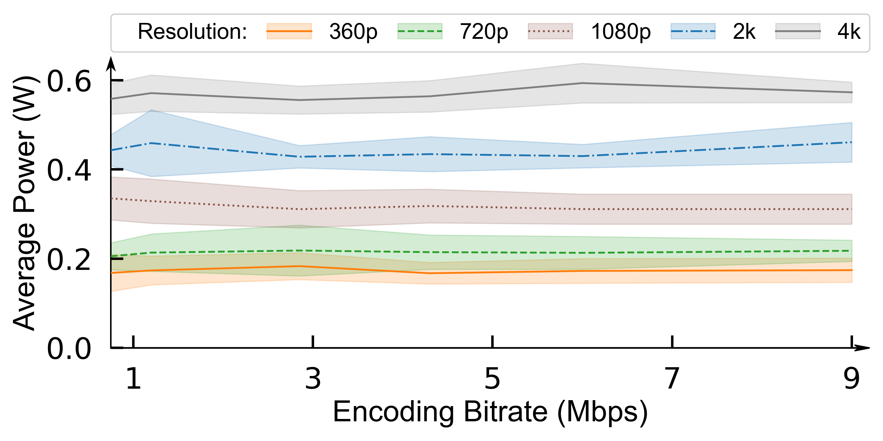
Modelling Power Consumption
Limitations of existing models
Designed based on encoding bitrate
Device heterogeneity
Our approach
Considers ABR-related components
Targets to capture pattern
Minimizes device specific impacts
Excludes base power consumption

Slide 34
Evaluation Setup
Videos
Three-minute videos
Tears of steel (sci-fi), Nature(documentary), BBB(cartoon)
Energy Data Collection
Videos are played for each representation
Monsoon Power meter collects at each 200 microseconds
Results are aggregated for each chunk
Trace Type | Avg. Band. (Mbps) | Distribution %
3G | 1.29 ± 0.77 | 29%
4G | 31.58 ± 13.59 | 14%
Broadband | 3.91 ± 2.37 | 28%
Synthetic | 4.41 ± 5.03 | 29%
Model | SRCC
SQoE-III sample | 0.6534
Pensieve | 0.6563
Comyco | 0.7517
Proposed Model | 0.7845
Perceptual Quality Calculation
QoE of the streaming session
video quality, rebuffering time and frequency,
oscillations, quality switches
Linear regression model on SQoE-III[19] dataset
VMAF is used as quality measure
34 users 450 videos 13 net. conditions

Slide 35
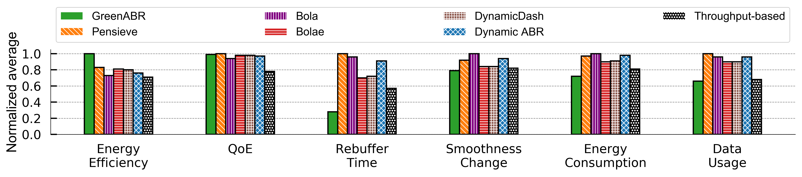
Results - 6 representations
Resolution | Bitrate(kbps)
320 x 180 | 300
640 x 360 | 750
768 x 432 | 1200
1024 x 576 | 1850
1280 x 720 | 2850
1920 x 1080 | 4300
Average results of 3 videos for all traces
Energy Efficiency (QoE/Energy) => 17-29 % better
QoE => 1% degradation
Rebuffering => 49-72 % lower
Smoothness => 2-21 % lower
Energy => 11-28 % savings
Data => 3-44 % savings

Slide 36
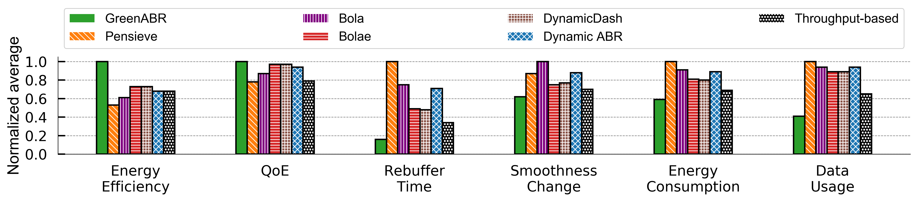
Results - 10 representations
Resolution | Bitrate(kbps)
320 x 180 | 150
320 x 180 | 300
640 x 360 | 750
768 x 432 | 1200
1024 x 576 | 1850
1280 x 720 | 2850
1920 x 1080 | 4300
1920 x 1080 | 6000
1920 x 1080 | 9000
1920 x 1080 | 12000
Average results of 3 videos for all traces
Energy Efficiency (QoE/Energy) => 27-47% better
QoE => 3-22% better
Rebuffering => 53-84 % lower
Smoothness => 16-31% lower
Energy => 15-41% savings
Data => 36-59% savings

Slide 37
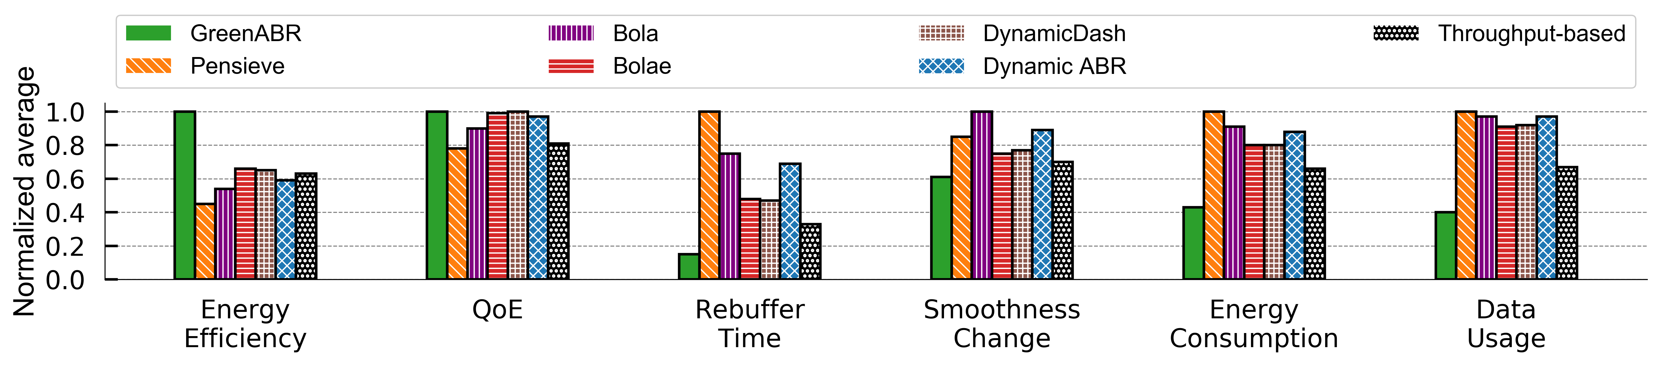
Results - 10 representations HD
Resolution | Bitrate(kbps)
320 x 180 | 150
320 x 180 | 300
640 x 360 | 750
768 x 432 | 1200
1024 x 576 | 1850
1280 x 720 | 2850
1920 x 1080 | 4300
1920 x 1080 | 6000
2560 x 1440 | 9000
3840 x 2160 | 12000
Average results of 3 videos for all traces
Energy Efficiency (QoE/Energy) => 34-55% better
QoE => 1-22% better
Rebuffering => 55-85 % lower
Smoothness => 13-39% lower
Energy => 35-57% savings
Data => 41-60% savings

